Slide 1
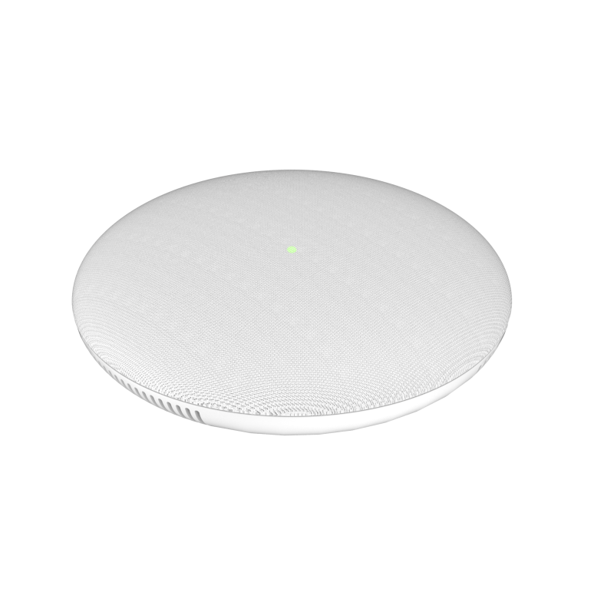
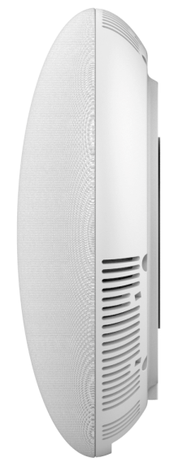
GSC3510 SIP Intercom Speaker/Microphone
The GSC3510 is a SIP intercom speaker/microphone that allows offices, schools, hospitals, apartments and more to build powerful voice intercom solutions that expand security and communication. This robust SIP intercom device offers 2-way voice functionality with both a high-fidelity 8W HD speaker and 3 directional microphones with Multichannel Microphone Array Design (MMAD) that offer a 4.2 meter pickup distance.
Competitive Features
Full-duplex speakerphone with HD acoustic chamber
3-directional mics
Full-band and wide-band audio codec
Integrated dual-band 802.11 a/b/g/n WiFi
Integrated Bluetooth support
Web-UI access for control/configurations
One 10/100Mbps port with PoE/PoE+
2-pin multi-purpose input
 | GSC3510 | Cyberdata 011272 SIP Indoor | Cyberdata 011186 SIP Outdoor
Network Interfaces | One 10/100 Mbps port with integrated PoE/PoE+ | 10/100 Mbps | 10/100 Mbps
Power | Integrated PoE/PoE+ | PoE 802.3af compliant or +8 to +12VDC @ 1000mA Regulated Power Supply (not included) | PoE 802.3af compliant or +8 to +12VDC @ 1000mA regulated power supply (not included)
Bluetooth | Yes, Integrated. Bluetooth 4.0 + EDR | No | No
WiFi | Yes, Integrated dual-band 802.11 a/b/g/n WiFi
Audio | Full-band and wide-band audio codec support | Full duplex voice operation | Full duplex voice operation
Security | SSL/TLS 1.2, AES256, SRTP, HTTPS, 802.1x media access control and in-band authentication | TLS/SSL 1.2 | TLS/SSL 1.2
Temperature and Humidity | Operation: 0°C to 40°C, Storage: -10°C to 60°C, Humidity: 10% to 90% Non-condensing | Operation: -40°C to 55°C, Storage: -40°C to 70°C, Humidity: 5% to 95% Non-condensing | Operation: -40°C to 55°C, Storage: -40°C to 70°C, Humidity: 5% to 95% Non-condensing
Voice Codecs | G.711µ/a, G.722 (wide-band), G.726-32, iLBC, Opus, G.729A/B in-band and out-of-band DTMF (In audio, RFC2833, SIP INFO), VAD, CNG, AEC, PLC, AJB, AGC, ANS | G.711 a-Law, G.711 μ-Law, G.722 and G.729 | G.711 a-Law, G.711 μ-Law, G.722 and G.729
Full-duplex speakerphone
Integrated dual-band WiFi
3-directional microphones
Integrated Bluetooth 4.0

